Slide 1


MMV 11/0047 – CBT antimalarials
S. No. | Target ID | Amount | Start Date | Status | Slide No
1 | Target-1 | 50 mg | 13th April-2012 | Ongoing | 2
2 | Target-2 | 50 mg | 16th Apr-2012 | Ongoing | 3
3 | Target-3 | 5 g | 17th Apr-2012 | Ongoing | 5
4 | Target-4 | 50 mg | 13th Apr-2012 | On Hold | 7
5 | Target-5 | 50 mg |  | SM received, going to start ASAP | 8
6 | Target-6 | 50 mg |  | Intermediate synthesized under target-10 will be SM here | 9
7 | Target-7 | 5 g | 16th Apr-2012 | Ongoing | 10
8 | Urea Library | 19 x 50 mg | 11th Apr-2012 | Ongoing | 11
9 | Target-8 & 9 | 2 x 50 mg |  | SM ordered, yet to receive | 12
10 | Target-10 | 50 mg | 13th Apr-2012 | Ongoing | 13
Confidential

Slide 2
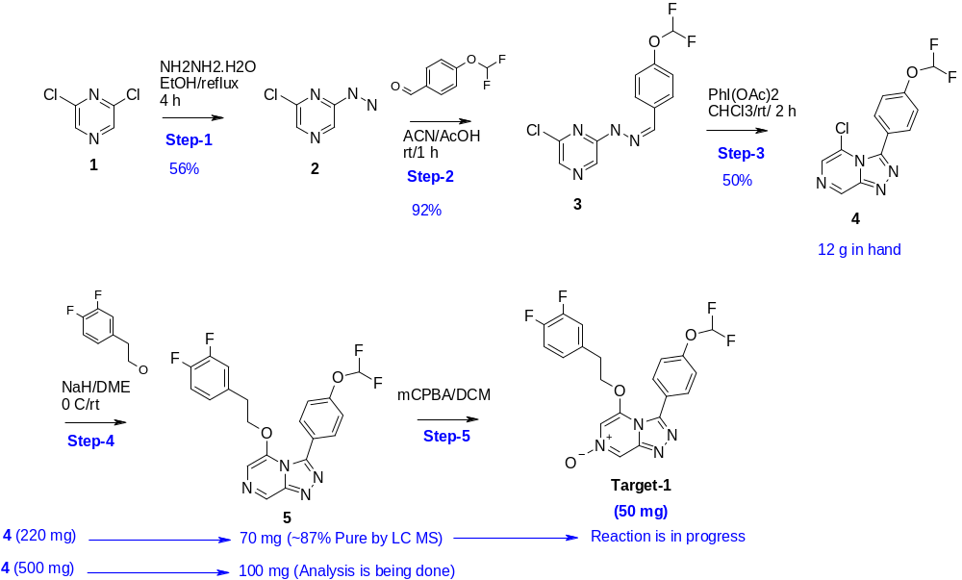
Target-1 (50 mg)
Synthetic Scheme-1
Confidential

Slide 3
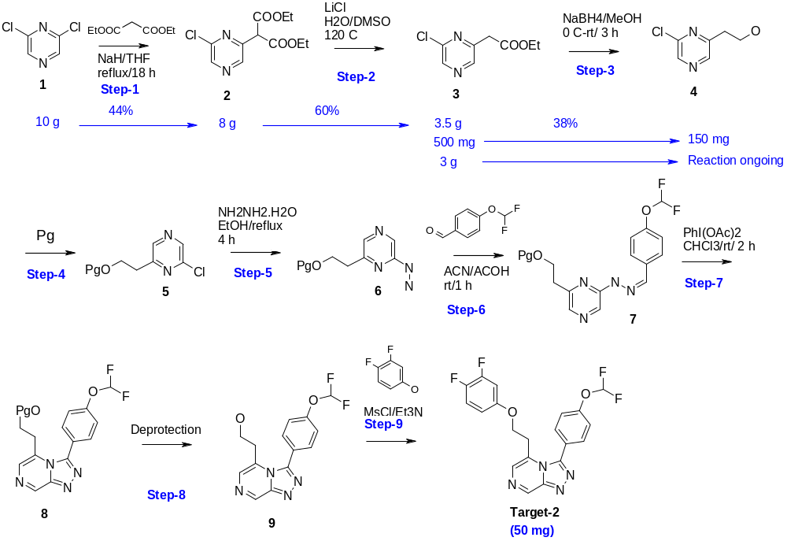
Target-2 (50 mg)
Synthetic Scheme-1
Confidential

Slide 4
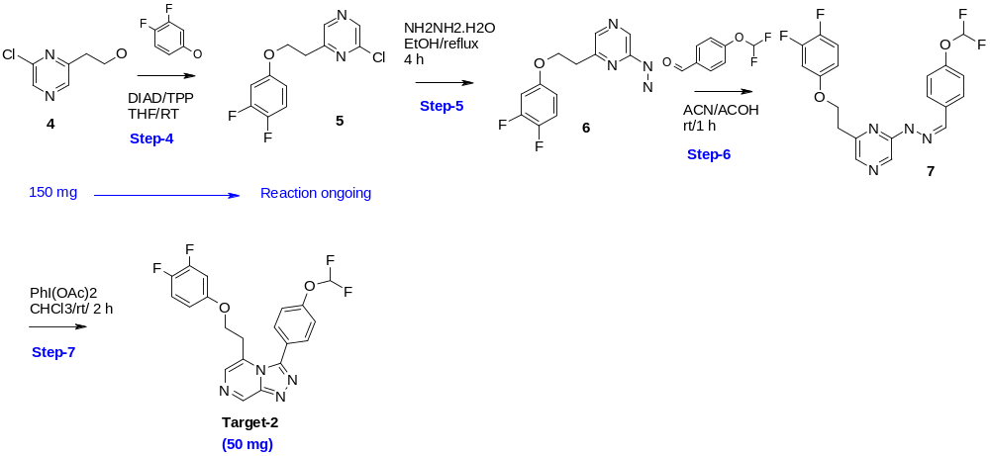
Target-2 (50 mg)
Alternate Synthetic Scheme-2
Confidential

Slide 5
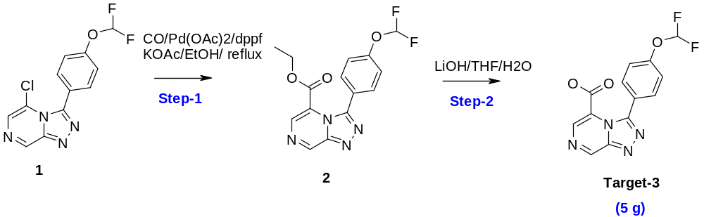
Target-3 (5 g)
Synthetic Scheme-1
Reaction tried:
Step No | Conditions | Result
Step-1 | Batch-1: Compd-1(200 mg, 0.67 mmol)/DPPf (0.03 eq)/Pd(OAc)2 (0.002 eq)/ NaOAc (2.1 eq)/CO/Ethanol at 100 º C/12h. | As per TLC SM remained intact
 | Batch-2: Compd-1 (100 mg, 0.336 mmol)/Zn(CN)2 (1.5eq)/Pd(PPh)3 (0.1eq)/ DMF (2 ml)/100 º C/4 h. | As per TLC SM remained intact
 | Batch-3: Compd-1 (100 mg)/Mo(CO)6 (1eq)/Pd(OAc)2 (0.07eq)/DBU (2eq)/Ethanol at 100deg/6h | Ethoxy group displacement occurred
 | Batch-4: Compd-1 (100 mg, 0.336 mmol)/CuCN(2.5eq)/ NMP/140 º C/12h. | As per TLC SM remained intact
 | Batch-5: Compd-1 (100 mg, 0.336 mmol)/KCN (2eq)/NMP/120 º C/12h. | Purification is in progress.
Confidential

Slide 6
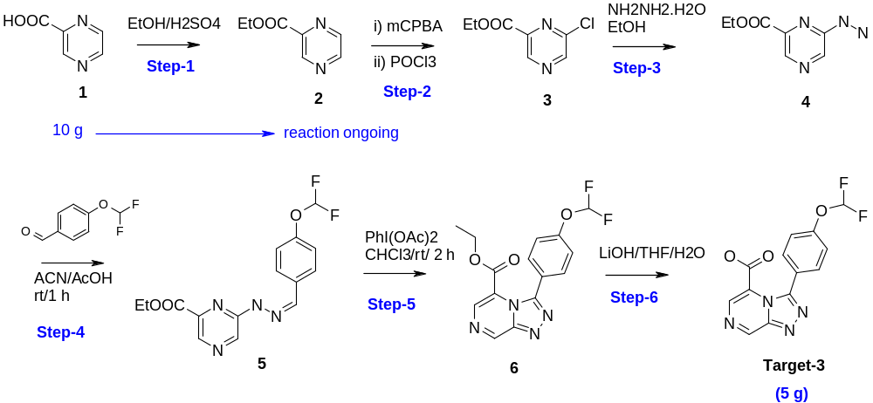
Target-3 (5 g)
Alternate Synthetic Scheme-1
Confidential

